Slide 1
Science Fair Introduction to Research
All materials taken from Knisely, Karin. (2009). Writing in Biology. Sinaur/Freeman.

Slide 2
Scientific Method: Asking Questions
(not always in rigid order)
Asking questions
Phenomena must be measureable and controllable
Example: dwarf pea plants contain a lower concentration of the hormone gibberellic acid than wild type plants of normal height.
Good testable question: Does gibberellic acid regulate plant height (measurable)
Poor question: Will the addition of gibberellic acid increase a plant’s sense of well being (not measurable).

Slide 3
Looking for sources that might help answer the questions. (Research strategies)
Primary References: journal articles of original research
Secondary References: encyclopedias, textbooks, articles in popular magazines.
Databases:
Google: http://www.google.com (show options, wonderwheel and timeline)
Google scholar http://scholar.google.com/
PubMed http://www.ncbi.nlm.nih.gov/pubmed/
Scirus http://www.scirus.com/srsapp/

Slide 4
How to search for a topic:
Pick keywords (example: dwarf pea plants gibberellins)
Refine keywords from search engine (search within a topic: Google)
Read a few abstracts; if you see a scientist’s name pop up repeatedly go to their web pages, sometimes they have links to full articles
Look for “review articles” and look at their reference sections for more articles.
Wikipedia also has primary sources listed at the end of their pages.
Open a word document to paste in URL and full references for later use.

Slide 5
Developing possible explanations
hypotheses- if (independent variable) and then (dependent variable).
Example:
Adding GA (gibberellic acid) to dwarf plants will allow them to grow to the height of normal, wild type plants.

Slide 6
Designing an experiment to test a hypothesis
set up treatment and control groups, identify variables, multiple trials
Experiments are studies in which the investigator imposes a specific treatment on an organism or thing while controlling the other factors that might influence the response (confounding factors need to be avoided).
Remember the hypothesis contains the independent variable, the dependent variable, and the prediction

Slide 7
Designing an experiment to test a hypothesis (con’t).
The Null Hypothesis is usually understood and rarely stated but reflects the idea that there will be NO change or NO effect of the independent variable on the experimental set up or treatment. The Null Hypothesis is not necessarily the “opposite” effect of the treatment, sometimes you have completely novel effects (example Rogaine (blood pressure) or Viagra (chest pain in men)).

Slide 8
Designing an experiment to test a hypothesis (con’t).
Define the variable:
Independent variable (alternative name explanatory variable): explains or influences the response (example time)
Dependent variable: affected by imposed treatment, organism’s response (example: color change, size, number of seeds produced, velocity of an enzyme reactions… can be measured or observed)
Standardized or controlled variables: common environments, procedures or treatments (example: all subjects are freshmen, test given 4th period, same temperature…)

Slide 9
Designing an experiment to test a hypothesis (con’t).
Treatment (experimental set up) and control groups:
Example:
Pea plants receiving variable concentrations (amounts) of gibberellic acid = treatment group… peas receiving only same volume of liquid with only water = control group.
Negative control: dwarf plants + no gibberellic acid (just = volume of water)
Positive control: wild type (normal height) plants + no gibberellic acid (just = volume of water)
Note: need to do research to determine range of concentrations of GA given.
Need multiple treatments (no less than 5), data collected from one plant isn’t statistically significant.

Slide 10
Designing an experiment to test a hypothesis (con’t).
Predicting what the outcome of an experiment will be if the hypothesis is upheld (because)
Adding GA (gibberellic acid) to dwarf plants will allow them to grow to the height of normal, wild type plants.
Positive result: expect dwarf plants to grow to normal range of height. Because GA is a plant growth hormone.
Negative result (Null Hypothesis supported): dwarf plants not affected by GA remain short because GA would not affect growth.
Negative control: (dwarf plants + no GA) expect dwarf plants
Positive control: (wild type + no GA) expect tall wild type plants.

Slide 11
Collection of appropriate data (qualitative or quantitative- units).
Investigator’s name(s)
The date (month, day, year)
The purpose
The procedure (in words or in flow chart)
Numerical data, with units of measurement, recorded in a data table
Drawings with dimensions and magnification, where appropriate. Structures are drawn in proportion to the whole object. Parts are labeled clearly. Observations about the appearance, color, texture, etc. are included.
Graphs, printouts, and gel images, etc.
Calculations (either handwritten or printouts).
A brief summary of the results.
Questions, possible errors, and other anecdotal notes.

Slide 12
Organizing possible explanations for the experimental results
What to do with raw data:
Decide if the data is trustworthy or erroneous
You may need to repeat the experiment if data is untrustworthy
Quantitative data: Graph data to look for obvious patterns, try X-Y scatter and show trendlines if appropriate. Look at the slope (y=mx+b) to see if trends are positive or negative.
Qualitative data: Use bar graphs with categorical data (no units)
Statistics: mean, standard deviation, Chi-Square, standard error, etc.

Slide 13
Organizing possible explanations for the experimental results (con’t).
Analyze data, do results support or refute hypotheses, or null hypothesis.
Compare results to the primary references you consulted before you developed your experiment.
Is there any difference between the control and the treatment group (supports null hypothesis).
Use primary research to provide support for your findings.
If your results were different take into account differing methods, organisms, and conditions.
Any sources or errors?

Slide 14
Organizing possible explanations for the experimental results (con’t).
Revising original hypotheses to take into account new findings.
Designing new experiments to test the new hypotheses (or other experiments to provide further support for old hypothesis)
Sharing finds with others (lab reports, slide presentations, etc).

Slide 15
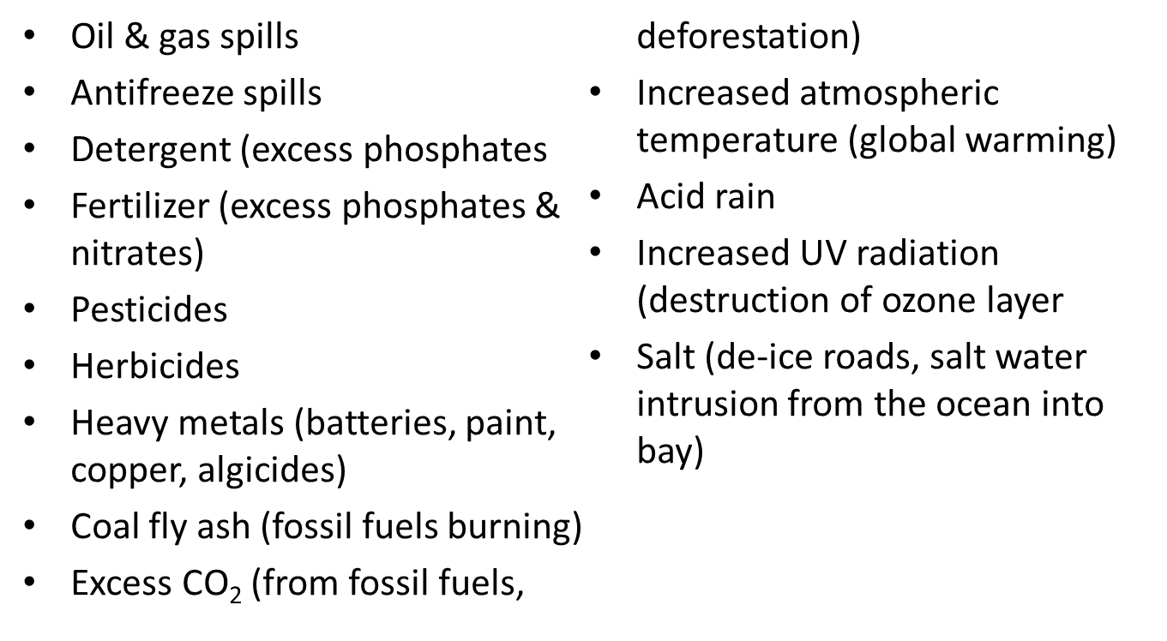
Ideas to Investigate

Slide 16
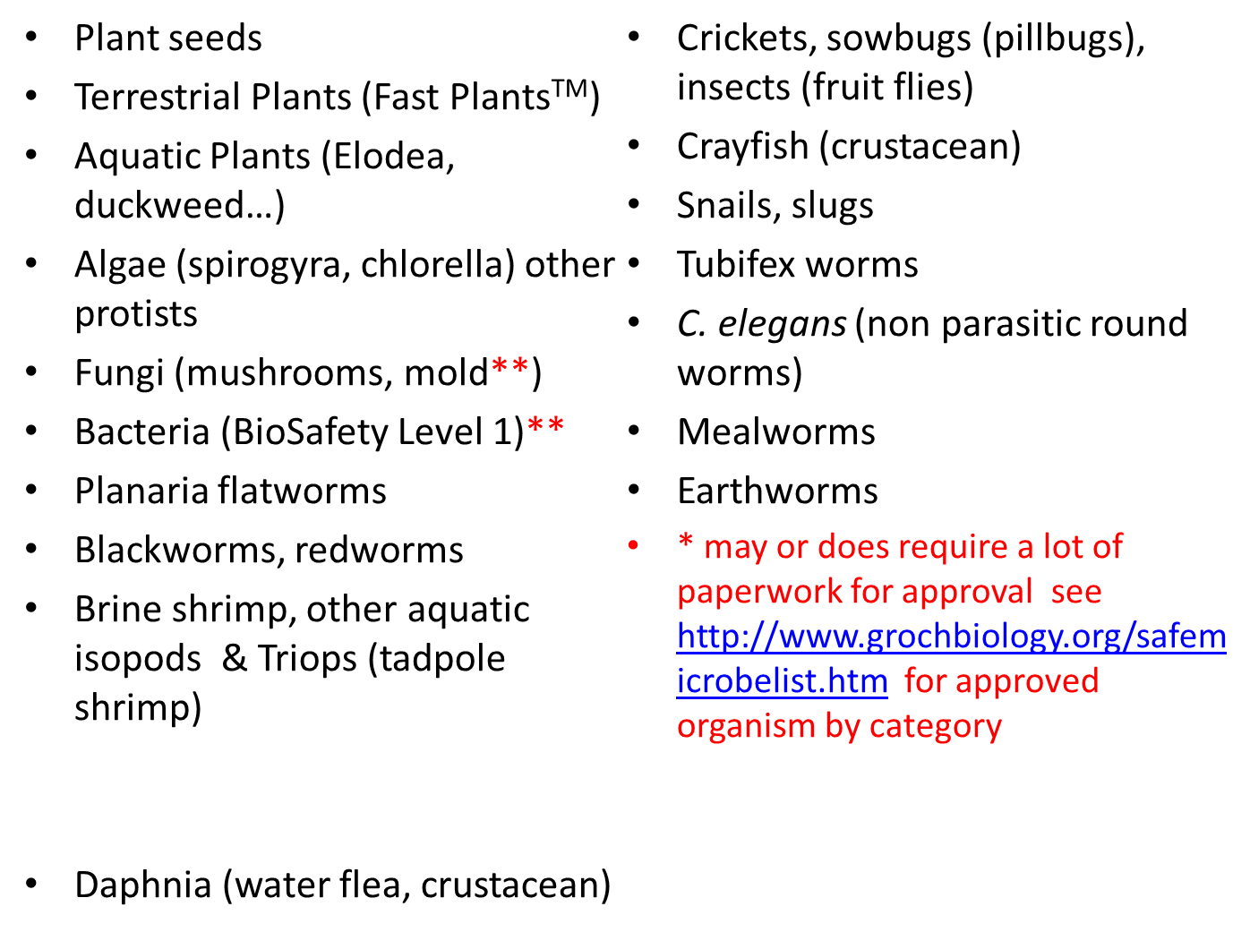
Organisms to Use (avoid vertebrates*)

Slide 17
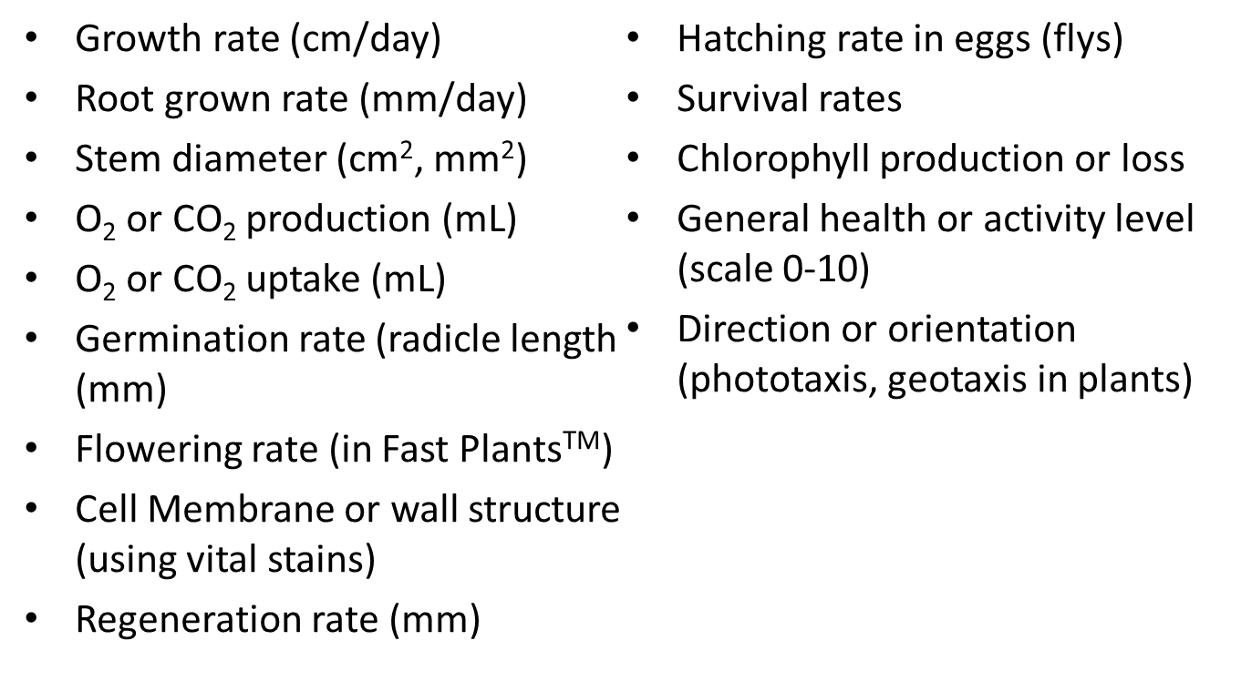
What to measure?
(with example units)

Slide 18
Ideas to ponder…
Do natural pesticides (such as plant extracts) work?
Do natural microbicides work?
Do natural fertilizers work?
Is organic phosphate (from bone meal) superior to non-organic phosphate as a fertilizer?
Are phosphate-free detergents safer on organisms?
Are natural barriers more effective at keeping slugs away from plants?
Which materials best absorb & store heat from solar energy?
Which plants are the best CO₂ sinks (removing CO₂)?
What is the effect of variables such as temperature, light, or moisture on composting rate?

Slide 19
More ideas….
What is the effect of variables such as temperature, light, or moisture on biodegradation rate in a landfill?
Do biodegradable/compostable food packages degrade faster?
Is environmentally safe antifreeze really safer for organisms?
Which plants remove excess phosphates or nitrates from the soil or water best?
Are road salting alternatives (MgCl₂, CaCl₂, KCl) really safer on wildlife than regular salt, NaCl?

Slide 20
How to do References
References: (use www.bibme.org pick APA format
Journal Article: Bibliography: Author’s last name, year of publication; 2 authors last names, year of publication; more than 3 authors; First Author’s last name and others or use “et al”, year of publication… example: Smith, J, Wilson, A. 2009. How to Write a Reference. Journal of Writing Biology. Date Accessed 7/8/09. URL: www.writingbiology.com.,
Book: Author’s Last name. Year. Title of Book. Publisher. Pages used.

Slide 21
In Paragraph Citations
2 choices:
Use superscripts to refer to Reference Section
Example:

